Slide 1
Post Treatment Endodontic Disease
S P MANTRI
Prof & Head,
Conservative Dentistry Endodontics
HDCH.

Slide 2
SUCCESS RATE OF ENDODONTIC DISEASE
Initial treatment of vital/necrotic teeth
93-98%
Initial treatment of teeth with AP
73 – 86% 10 - 15% less than vital/necrotic
Retreatment of teeth with AP
62 – 84%
10 - 20% less than initial Tx of teeth with AP
Engström et al., 1964;
Sjögren et al., 1990
Hoskinson et al., 2002;
Strindberg 1990;
Ørstavik et al., 1996 & 2004;
Peters et al., 2004;
Marquis et al., 2006
Strindberg 1956
Engström et al., 1964;
Sjögren et al., 1990;
Farzaneh et al., 2004;

Slide 3
Possible/no influence
Systemic health
Age and gender
Preoperative symptoms
Periodontal status
Type and location of the tooth
Size of the periapical lesion
Pulp status in initial treatment
Time elapsed since the initial treatment in retreatment
Quality and length of previous root filling
Essential influence • Presence of apical periodontitis
Possible/ no influence
Type of restoration
Quality of restoration
Time lapse between root filling and restoration
Clinical
outcome
Preoperative
Postoperative
Intraoperative
Possible/ no influence
Instrumentation techniques
Hands vs engine-driven
Stainless steel vs Nickel-Titanium
Taper, hybrid, lateral & vertical compaction
Type of sealer
Number of treatment sessions
Flare-up or pain
Complications
Probable influence
Apical size of the root filling
Apical length of the root filling
Bacterial detection at the root filling stage

Slide 4
Prognosis
of
Retreatment
Inadequate root-filling
86% de Chevigny et al., JOE 2008
Adequate root-filling
50% de Chevigny et al., JOE 2008
Microbiota
A polymicrobial community
Mostly G-negative anaerobic
Easy to eradicate
A greater chance to be properly cleaned, disinfected and filled
Pinheiro et al., IEJ 2003
Microbiota
A polymicrobial community
Mostly G-positive facultative
Persist more frequently
Remain untouched by disinfection, or established extraradicular
Byström & Sundqvist, Scand J Dent Res 1981, Gomes et al., IEJ 1996

Slide 5
Intra - & extra-radicular biofilms & Cysts
Prevalence of Biofilm
 | Untreated (%) | Treated (%)
Intra-radicular | 80 | 74
Extra-radicular | 6 | 5
Prevalence of apical cysts
Study | Cyst among all lesions, n (%)
Simon 1980 | 6/35 (17)
Nair et al, 1996 | 39/256 (15)
Ricucci et al, 2020 | 23/95 (24)
Riccuci & Siqueira JOE 2010;
Riccuci et al., JOE 2020

Slide 6
Chemo-mechanicalpreparation
Anatomical complexities and Iatrogenic complications
Substantial part of the root canal wall is left untouched (Peters et al., 2015; Paqué et al., 2010, 2011)
20-35% of root canals retained pulp tissue and debris after instrumentation (Siquiera et al., 2018)
More pronounced in oval or ribbon-shaped canals (Varela et al., 2018)
Canal curvature and calcification affects the working length (WL) (Tang et al., 2011)
Iatrogenic complications affects the reaching the WL
Morphology has an impact on retreatment success(Gorni & Gogliani, 2004)
The goal
1. Mechanical removal of the vital and/or necrotic tissue and microbial biofilms
2. Optimal flow of irrigantsfor chemical debridement and disinfection
3. Placement of a filling inside the cleaned and shaped root canal space
(Siquiera et al., 2002; De-Deus et al., 2010; Neelakantan et al., 2016; Lee et al., 2019)
Mechanical
preparation
Mechanical effects
Detachment and removal of microbes or biofilms, pulp tissue remnants, dentin debris, and instrumentation products
Chemical effects
Dissolution of tissue remnants, dentin debris, smear layer, chemical disruption of biofilms,
killing of microorganisms, and inactivation of their by-products (Gublivala et al., 2005; Haapasalo et al., 2005; Zehnder 2006; Schäfer 2007)
Irrigation

Slide 7
Prevention or resolution of
apical periodontitis
Asymptomatic, functional tooth with healthy
periapical tissues
Asymptomatic/symptomatic,
functional / not functional
with diseased periapical tissue
A review of the prognostic value of irrigation on root canal treatment success. Chubb et al., AustEndod J 2019

Slide 8
Low cost
optimal irrigation
Cleaning
effect
Lubrication
Notallergenic
Dissolves organic & inorganic components
No adverse effects
Dissolves biofilm
Antimicrobial
Good flow

Slide 9
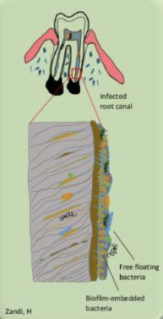
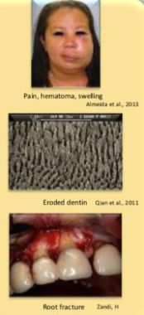
Objective
Disinfect Without causing harm

Slide 10
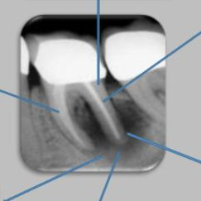
Inactivation of root canal medicaments by dentin
• Dentin matrix and hydroxyapatite
• Type-I collagen
• Proteins (e.g. albumin)
Resistant microorganisms
Gram-positive facultative
• Streptococcus spp.
• Enterococcus spp.
• Actinomyces spp.
Gram-negative anaerobes
Fusobacterium spp.
Prevotella spp.
Fungi
• Candida albicans
Factors challenging the
antibacterial agents
Biofilm-embedded
microbiota
Microbiota in anatomical complex areas
Isthmuses
Lateral canals
Fins
Irregularities
Anastomosis
Dentinal tubules
Cyst
• Pocket
• True
Extra-radicular infection
Actinomyces spp.
Propionibacterium spp

Slide 11
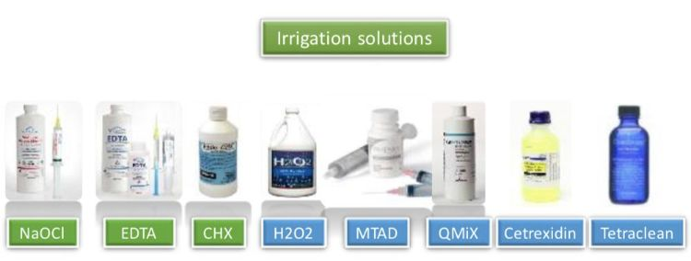

Slide 13
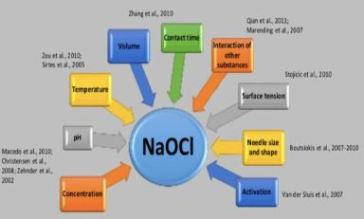
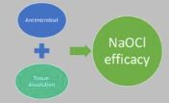
NaOCl Efficacy
Concentration
pH
Volume
Contact Time

Slide 14
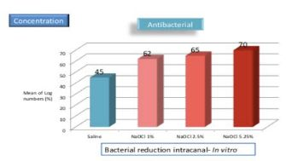
Chemomechanical reduction of the bacterial population in the root canal after instrumentation and irrigation with 1%, 2.5%, and 5.25% sodium hypochlorite. Siqueira et al., JOE 2000
Retamozo et al., 2010; Wong et al., 2014; Dumitriu et al., 2015; Cameron et al., 1988; Sim et al., 2000; Zhang et al., 2010; Parirokh et al., 2012; Martin et al., 2014; Pashley et al., 1985; Li et al., 2022

Slide 15
pH & Buffering
2.5% NaOCl more effective than 0.5% in tissue dissolution
Unbuffered and buffered 0.5% NaOClwere equally effective.
The amount of available chlorine, not osmolarity, pH, or buffer capacity is responsible for the tissue dissolving properties.
Lowering the pH from 12 to 9 did not render the solution less aggressive on fresh tissue.
No difference between the antibacterial effect in buffered or unbuffered solution!
Tissue-dissolving capacity and antibacterial effect of buffered and unbuffered hypochlorite solutions. Zehnder et al., 000 2002

Slide 16
Temperature
Dissolving human pulpal tissue 1% NaOCl (10 ml)
20°C, 45°C, 60°C
20°C → 45°C (7 min)
20°C → 60°C (20 min)
1% NaOCl (45°C) = 5.25% NaOCl (20°C)
100 times more efficient in killing bacteria from 20°C to 45°C
The effects of temperature on sodium hypochlorite short-term stability, pulp dissolution capacity, and antimicrobial efficacy. Sirtes et al., JOE 2005
Surface Tension
Tissue dissolving increased with increased concentration, temperature and activation.
NaOCl with surfactants was the most effective .
Tissue Dissolution by Sodium Hypochlorite Effect of Concentration, Temperature, Agitation, and Surfactant. Stojicic et al., JOE 2010

Slide 17
Mechanical Properties
There is strong evidence showing that NaOCl adversely alters the mechanical properties of root dentine.
Effect of sodium hypochlorite on dentine mechanical properties. A review. Pascon et al., J Dent 2009
Dentin Integrity
2.5%, 3%, 5%, 5.25, 9%, 10% Significantly reduced the strength of dentin.
0.5% and 1% least effect.
Effect of Different Concentrations of Sodium Hypochlorite on the Compressive Strength of Endodontically Treated Roots. Li et al., JOE 2022

Slide 18
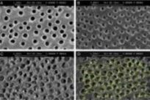
NaOCl & EDTA
Combined use of EDTA and 5% NaOCl was more efficient than NaOCl solutions alone.
The antibacterial action of sodium hypochlorite and EDTA in 60 cases of endodontic therapy. Byström & Sundqvist IEJ 1985
Irrigant solution sequence
EDTA dissolvesinorganic part of dentin and exposes the organic part.
NaOClat the end for 1 min, demineralizes further by removing the organic part and removing collagen type-1
Erosion of dentin
Quantitative analysis of the effect of irrigant solution sequences on dentin erosion. Qian et al., JOE 2011

Slide 19
NaOCl accidents
Extrusions into the periapical area.
Oxidation of the surrounding tissue, hemolysis and ulceration, destruction of fibroblasts, and endothelial cells, and prevention of neutrophil migration.
Severe pain and diffuse swelling and hemorrhage.
Localized paresthesia, necrosis, trismus, dyspnea, dysphagia, airway obstruction.
Interstitial bleeding with a risk of facial hematomas .
Maxillary incisors can cause ophthalmological injuries .
Maxillary sinus can cause liquid entering nostrils and throat.
Mandibular teeth can cause airway obstructions .
Anatomy of Sodium Hypochlorite Accidents Involving Facial Ecchymosis – A Review. Zhu et al., J Dent 2013

Slide 20
Low (0.5 – 1%) VS. High (2.5 – 5.25%) NaOCl
Clinical evidence
Antibacterial
Infected single-rooted
Culture-based RCT
No significant differences
Cvek et al., 1976; Byström et al., 1985; Soares et al., 2006
Postoperative pain
Infected mandibular molar
Lower in 1% group,
however no significant differences
Verma et al., 2019
Less intense and less frequent pain 1.3% than 5.25%
Mostafa et al., 2020
Clinical outcome
Infected mandibular molars
No significant differences between 1% and 5.25%
Verma et al., 2019

Slide 21
chlorhexidine (CHX)
+ +
Chloroguanide Hexamethylene chain Chloroguanide
Symmetric bis-biguanide, strong base, and insoluble in water.
Reacts with acids to form salts that are soluble; diacetate, digluconate.
Broad antiseptic spectrum .
0.12% - 2% (bacteriostatic – bactericidal).
Cytoplasmic membrane integrity, cytoplasmic leakage, coagulation and precipitation of intracellular constituents such as protein and nucleic acids
High binding affinity;substantivity .
Biocompatible; Less toxic to the vital tissue; eye irritation, ototoxic .
pH dependent and weak in the presence of organic tissue .
Lacks the tissue-dissolving ability

Slide 22
what happens if we mix CHX and NaOCl?
6 % NaOCl +2%CHX
0.023% NaOCl+ 2 % CHX
Para-chloroanilineprecipitate!
Toxic substance methemoglobin
Carcinogenic and possibly leakage
Blocks dentin canals

Slide 23
Zandi, H

Slide 25
Boutsioukis et al., IEJ 2010

Slide 26
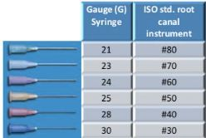
Ex vivo, 3 needles (25, 27 and 30 G)
Duration of delivery and flow rates significantly decreased as the needle diameter increased, whilst intra-barrel pressure increased up to 400-550 kPa .
Irrigant flow rate is the factor directly influencing flow beyond the needle (0.01 – 1.01 ml sec ̄1).
Boutsioukis et al., IEJ2007

Slide 27
Boutsioukis et al., IEJ 2014

Slide 28
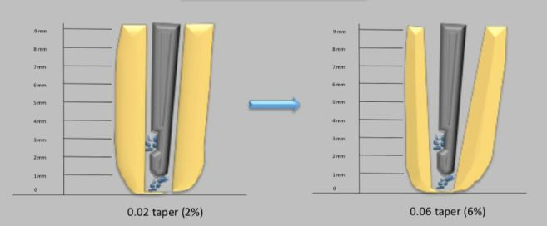
An increase in root canal taper improved irrigant replacement
and wall shear stress reducing the risk for extrusion.
Boutsioukis et al., IEJ 2010

Slide 29
Antibacterial & debris removal
CLINICAL
Ørstavik et al., 1991 Extensive apical reaming to larger sizes with only sterile saline as an irrigation solution reduced bacterial numbers by 10- fold
Dalton et al., 1998 Substantial bacterial reduction with progressive filing, regardless of file type. Fewer bacteria remain when larger file sizes were used.
Shuping et al., 2000 Instrumentation with 1.25% NaOCl was more effective than saline ONLY after increasing the apical size larger than #35
Card et al., 2002 100% of cuspid/bicuspid canals were rendered bacteria-free, and 81.5% of molars were bacteria-free using 1% NaOCl
McGurkin-Smith et al., 2005 Larger apical instrumentation using 5.25% NaOCl removed more bacteria than small apical sizes. Almost half of the root canals were still positive for bacteria
Rodriguez et al., 2017 Increasing the apical size improved the disinfection; however, 2.5% NaOCl were more efficient over sterile saline at sizes above #35
SIZE 35

Slide 30
The best current available clinical evidence, for patients with necrotic pulp & periapical lesions
greater enlargement of the apical size would result
in an increased healing outcome in terms of
radiographic and clinical evaluations.
Master apical file size - smaller or larger: a systematic review of healing outcomes. Aminoshariae & Khalid IEJ 2015

Slide 31
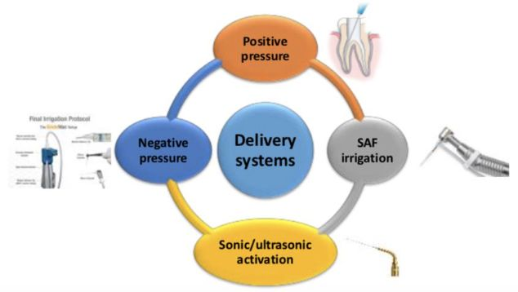

Slide 32
Endo vac Negative Pressure
Debris removal
Endovac was significantly better than needle irrigation at 1mm.
Comparison of the EndoVac System to Needle Irrigation of Root Canals. Nielsen et al., JOE 2007
Post-operative pain
significant reduction of postoperative pain levels in comparison to conventional needle irrigation.
Postoperative Pain after the Application of Two Different Irrigation Devices in a Prospective Randomized Clinical Trial. Gondim et al., JOE 2010
Systematic Review
The studies were limited by inadequate standardization, laboratory models not mimicking in vivo conditions, and poor description of the protocols
The level of available evidence is low and the results should be interpreted with caution
Apical negative pressure irrigation versus syringe irrigation: a systematic review of cleaning and disinfection of the root canal system. Konstantinidi et al., IEJ 2016

Slide 33
Passive ultrasonic irrigation (PUI)
1 min PUI resulted in a significant reduction of CFU-counts and positive canals
Chances of getting negative cultures increased 7 times with additional use of PUI
In vivo antibacterial efficacy of ultrasound after hand and rotary instrumentation in human mandibular molars. Carver et al., JOE 2007

Slide 34
Tissue Dissolution by a Novel MultisonicUltracleaning System and Sodium Hypochlorite
MultisonicUltracleaning System achieved a significantly faster tissue dissolution rate
Haapasalo et al., JOE 2014

Slide 35
Healing of Periapical Lesions after Endodontic Treatment with the GentleWave Procedure:
A Prospective Multicenter Clinical Study
GentleWave
Case series analysis
45 teeth in 45 patients
12 months, 97.8% recall rate
PAI ≥ 3 disease
Success classified a healing or healed without clinical signs
Success rate of 97.7%
. Sigurdssen et al., JOE 2018

Slide 36
THANK YOU

