Slide 1

DIAGNOSIS
Diagnosis is defined as the utilization of scientific measures to differentiate it from other diseased processes and also for identification of a diseased process .

Slide 2
DIFFERENTIAL DIAGNOSIS

Slide 3
HOW TO WRITE DIAGNOSIS ?
Overall
Tooth / teeth in question?
Caries?
Pulpal disease Periapical disease

Slide 4
CLINICAL SITUATIONS

Slide 5
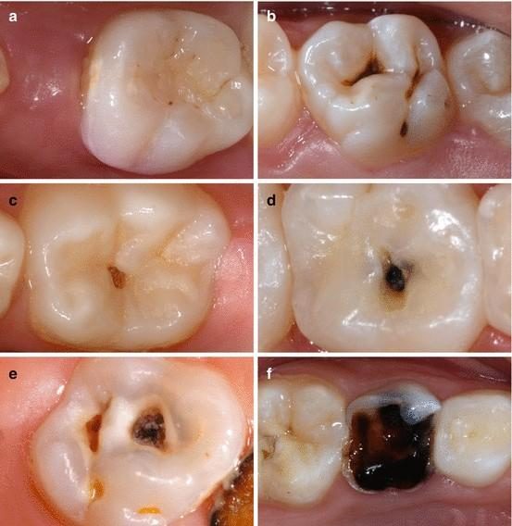
CLINICAL PICTURE

Slide 6
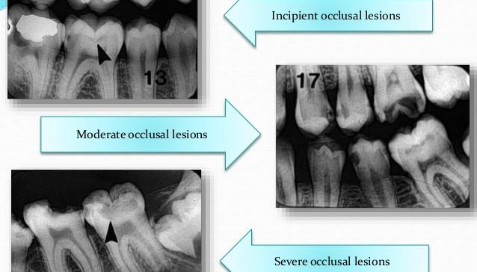
RADIOGRAPHIC APPEARANCE

Slide 7
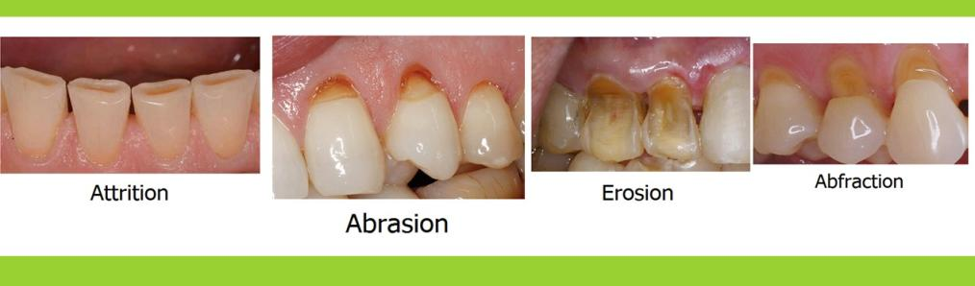
NON CARIOUS LESIONS

Slide 8
Patient name – Sandhya Singh Sex – female
Age - 26 YRS
Complains of pain in upper left back tooth region, which aggravates on eating hot food.
Pain increased on lying down|

Slide 9
Careful Clinical and radiographic examination revealed the presence of proximal caries on 15 and 16.
Thermal test with hot burnisher was carried out.
First the second premolar and first molar in the second quadrant was checked..

Slide 10
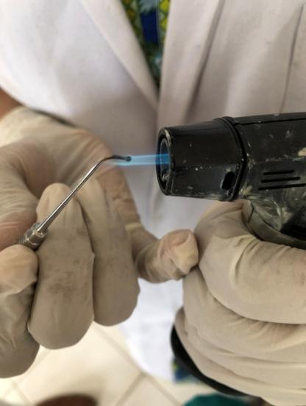
HEAT TEST

Slide 11
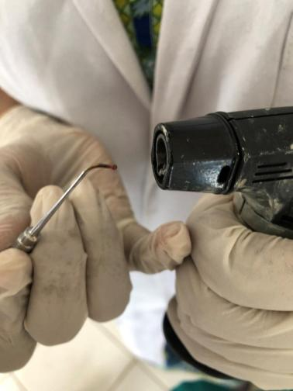
RED HOT BURNISHNER

Slide 12
RESULT
The patient experienced lingering pain that lasted even after removal of the stimulus. In both 15 , 16
Which is suggestive of irreversible puplitis in 15,16
The patient is advised Endodontic treatment in – 15 and 16

Slide 13
DIFFERENTIAL DIAGNOSIS
 | Reversible | Irreversible
Pain | Momentary | Continuous
Stimulus | Required | Required / Spontaneous
History | Recent restoration caries | Deep caries, trauma
Referred pain | Negative | Common finding
Pain on lying down | Negative | May be present
Color | No change | May be changed
Electric pulp test | Premature | Premature or delayed

Slide 14
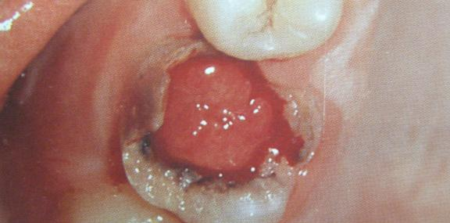
CASE

Slide 15
SURFACE BLEEDS EASILY WHEN TOUCHED OR
PROBED.
YOUNG CHILD.
TISSUE PROLIFERATING FROM A LARGE CARIOUS
EXPOSURE.
LESS SENSTIVE THAN NORMAL PULPAL TISSUE.
MORE SENSTIVE THAN
NORMAL GINGIVAL TISSUE.

Slide 16
DIAGNOSIS
PAIN IS ABSENT.
PERIAPICALLY RADIOGRAPHIC EVIDENCE IS LACKING.
DIAGNOSIS -PULP POLYP.
DIFFERENTIAL DIAGNOSIS- GINGIVAL POLYP

Slide 17
TREATMENT
ENDODONTIC THERAPY

Slide 18
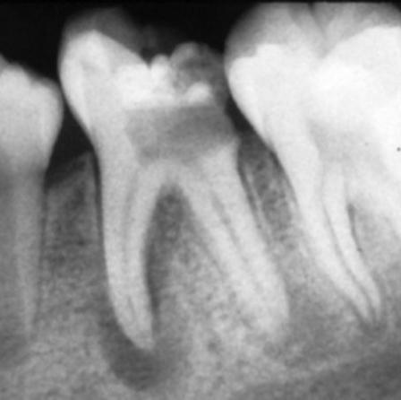

Slide 19
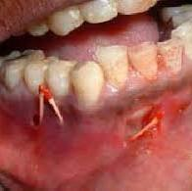

Slide 20
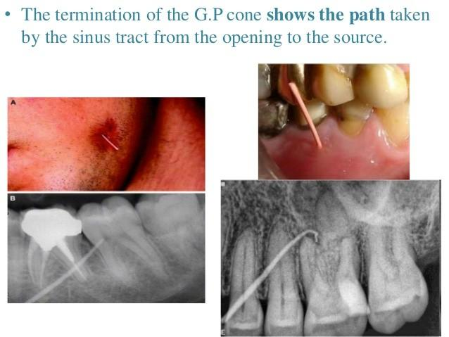

Slide 21
TREATMENT PLANNING
GOLDEN RULE →
what the patient needs most is performed first.
Treatment plan sequence:
Urgent phase Control phase Reevaluation phase Definitive phase maintenance phase

Slide 22
Urgent phase:
swelling, pain, bleeding or infection Control phase:
Eliminate active disease- caries, inflammation,
Remove conditions that prevent maintenance
Eliminate potential causes of disease Begin preventive methods.

Slide 23
Reevaluation phase: holding phase b/w control & definitive phases--. Allows for healing.
Reinforce home care habits

Slide 24
Definitive phase→ corrective phase, include endo, perio, ortho, oral surgical & operative procedures before FPD/ RPD.
Maintenance phase → recall examinations
→ need for adjustments
→ reinforce home care
→ recalls – deponds on pt’s risk
→ low risk – needs 9-12 months recall
→ high risk – needs 3-4 months recall

Slide 25
INTERDISCIPLINARY CONSIDERATIONS IN OPERATIVE TREATMENT PLANNING
To sequence operative care with: Endodontics
Periodontics Orthodontics
Oral surgery Occlusion
Fixed & removable prosthodontics

Slide 26
INDICATIONS
FOR OPERATIVE
TREATMENT
Operative preventive treatment: Caries preventive program –
for caries high risk pt.
Restoration of incipient lesion:
Poor oral hygeine
H/O caries on contralateral surfaces / numerous carious teeth
When cavitation is present
High degree of caries susc₂₆epatability

Slide 27
Treatment of abrasion, erosion & attrition:
When cariously involved
Defect is deep or close to pulp
Intolerable sensitivity.

Slide 28
TREATMENT PLAN APPROVAL:
Provide the patient with alternative therapies available & their advantages, disadvantages & risk associated with each alternative therapy to be discussed
Discuss treatment Cost

Slide 29
SUMMARY & CONCLUSION
Proper diagnosis & treatment planning play a critical role in dental care.
Evaluate the patient thoroughly.
Develop the treatment plan.
Take an informed written consent.

