Slide 1
RESTORATIVE
RESINS
Dr. Akshara shrivastava

Slide 2
Also known as Tooth colored materials ,
used in the restoration of natural teeth.

Slide 3
TOOTH COLORED RESTORATIVE MATERIALS
Silicate cements
Glass Ionomer cements
Unfilled resins
Composite resins
Porcelain (veneers, crowns)
Porcelain bonded to metal crowns
Restorative Resins

Slide 4
RESTORATIVE RESINS ::
These are synthetic resins , evolved as
restorative materials principally because
of their Esthetic Characteristics.
TYPES –
Unfilled = e.g. Acrylic Resins
Filled = e.g. Composite Resins

Slide 5
UNFILLED ACRYLIC RESINS used late 1960’3 through early 1970’s .
Advantages - tooth coloured
- did not wash out
- highly polishable
- moderately strong
Disadvantages - not colour stable
- shrinkage/leakage

Slide 6
COMPOSITION
Powder :
Polymethyl Methacrylate
Benzoyl Peroxide - Initiator
Color pigments
Liquid :
Methyl Methacrylate monomer
Ethylene dimethacrylate (5%) – Cross linking
agent .
Hydroquinone (0.06%) – Inhibitor .

Slide 7
PROPERTIES
MECHANICAL PROPERTIES –
Less Compressive Strength = 69 MPa
Low Tensile Strength = 24 MPa
Low Proportional limit .
Low Hardness = 15 KHN
Low Abrasion resistance .

Slide 8
THERMAL PROPERTIES –
** Very high Coefficient of Thermal
expansion - ( 92.8 x 10⁻⁶ / ⁰C )
“ It is 7-8 times greater than that of the tooth ”
** Low Thermal Conductivity .

Slide 9
POLYMERIZATION SHRINKAGE –
High 5 to 8 % .
SOLUBILITY –
Insoluble in water & oral fluids.

Slide 10
ADHESION –
Does not adhere to Enamel or Dentin.
ESTHETICS –
Excellent matching with tooth color, but tends
to discolor.
BIOCOMPATIBILITY –
Monomer can penetrate dentinal tubules &
cause irritation to the pulp.

Slide 11
MANIPUPLATION
Bulk Technique or Pressure Technique
Incremental or Non-pressure Technique
Flow Technique

Slide 12
C O M P O S I T E
R E S I N S

Slide 13
It is a tooth colored restorative material ,
developed in early 1960’ s .
Features ::::
* Strengthened by adding Silica particles
* Acid Etching technique
* Bonding technique

Slide 14
A Composite is a system composed of a
mixture of 2 or more components , which
are essentially insoluble in each other and
differ in form.
Major components – Resin Matrix
Inorganic Filler

Slide 15
Advantages - tooth colored
- stain resistant
- polishable
- can be bonded to tooth
- strong
- wear resistant
Disadvantages - shrinkage (2-5%)
- longevity ??

Slide 16
USES
** Different Composites are available for
different purposes .
** They are usually not Interchangeable .

Slide 17
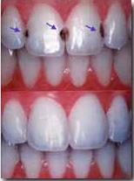
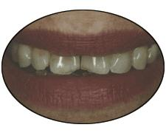
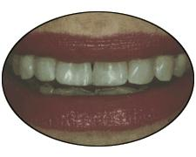
USES ::
Restoration of Anterior and Posterior teeth
-- Directly or as Inlays

Slide 18
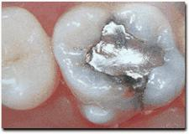
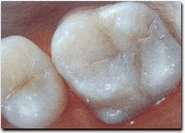

Slide 19
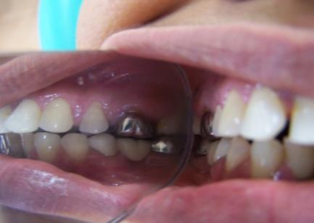
USES ::
To Veneer metal crowns and bridges .

Slide 20
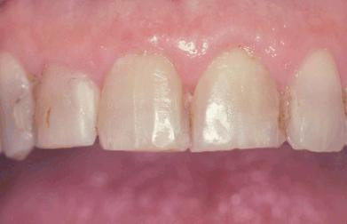
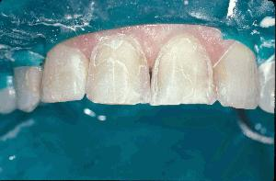
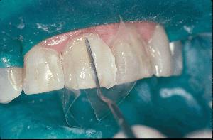
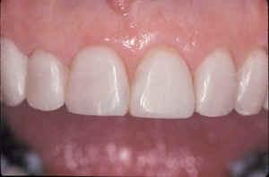
USES ::
Esthetic Laminates

Slide 21
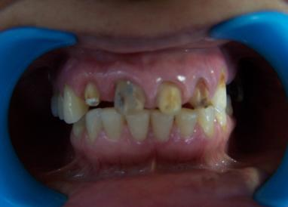
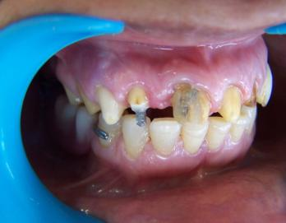
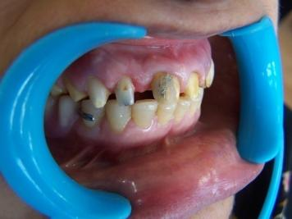
USES ::
To build up Cores (Post & Core).

Slide 22



USES ::
Pit and Fissure Sealant .

Slide 23
USES ::
Cementation of ,,,
Orthodontic brackets
Maryland Bridges
Ceramic Crowns , Inlays & Onlays
Ceramic Laminates .

Slide 24
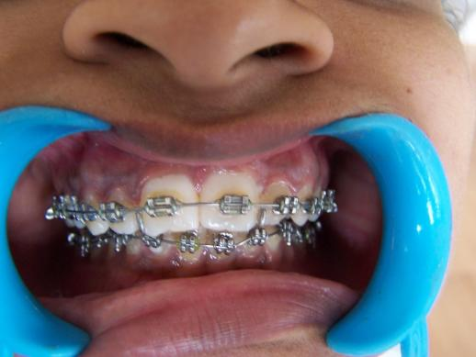
Cementation of Orthodontic brackets –

Slide 25
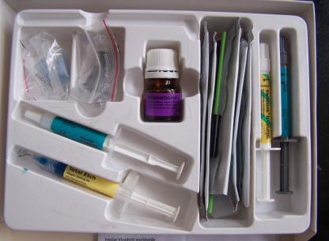
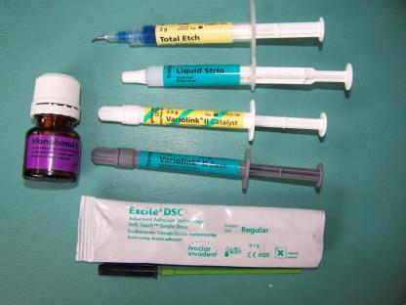
SUPPLIED AS –
In a kit containing ,,,,,
Syringes of composite
resin pastes in various
shades .
Etching liquid (37 %
Phosphoric acid) .
Enamel / Dentin
bonding agent .
Shade guide .

Slide 26
COMPOSITION
ORGANIC RESIN MATRIX –
BIS GMA or Urethane dimethacrylate , TEG DMA as a binder.
INORGANIC FILLER –
Quartz , Colloidal silica or heavy metal glasses.
COUPLING AGENT –
Organo silanes .
Notes:
BIS-GMA -- Bisphenol A – Glycidyl Methacrylate
TEGDMA - Triethylene Glycol Dimethacrylate

Slide 27
They also contain ,,,,,
Hydroquinone – inhibitor to prevent premature
polymerization.
UV absorbers – to improve color stability .
Opacifiers – titanium oxide & aluminum oxide.
Color Pigments – to match tooth color.

Slide 28
RESIN MATRIX
It is ------- 50 % by volume
25 % by weight
Most Composite resins utilize monomers that are
aromatic or Aliphatic diacrylates .
Commonly used monomers are ,,,,
BIS-GMA -- Bisphenol A – Glycidyl Methacrylate
UDMA -- Urethane dimethacrylate

Slide 29
Limitation Of Monomers ,,,,,,,
Extremely Viscous at room temperature .
To make it clinically acceptable
Diluent monomers are added to the resin matrix to ,,,,,
reduce the viscosity of the paste
allow more filler particles to be incorporated
allow cross-linking b/w chains

Slide 30
Commonly used Diluent monomer is
TEGDMA - Triethylene Glycol Dimethacrylate
They form highly cross linked polymer structure.

Slide 31
FILLER PARTICLES
Improves materials properties.
It is -------- 30 to 70 % by volume
50 to 85 % by weight
Advantages :::::
Curing shrinkage is reduced, as less resin is present
Reduces water sorption
Reduces Coefficient of Thermal expansion
Improves mechanical properties - like Strength,
Hardness, & Abrasion resistance.

Slide 32
TYPES OF FILLERS –
Composite resins use 3 types of fillers ,,,,
Quartz
Colloidal Silica
Glasses or Ceramic containing heavy metals

Slide 33
Factors that determine the properties &
clinical application of composites ,,,,,,
Amount of filler added
Size of particles & its distribution
Index of refraction
Radiopacity
Hardness

Slide 34
Amount of filler added –
Affected by the relative surface areas
large surface area -- small amounts of filler
e.g. - colloidal silica

Slide 35
Size of particles –
In order to increase the filler amount in the resin, it is
necessary to add the fillers in a range of particle sizes.
Refractive Index –
Filler should have a translucency similar to the tooth
structure.
Most glass & quartz fillers have a refractive index
of 1.5 .

Slide 36
Radiopacity –
Provided by a number of glasses and ceramics
that contain heavy metals such as barium,
strontium and zirconium .
Most commonly used is a Barium Glass .

Slide 37
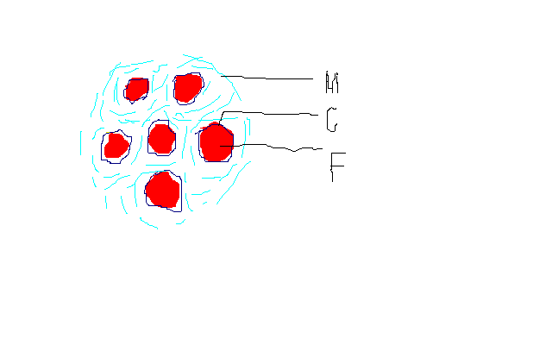
COUPLING AGENTS –
Bond the filler particles to the resin matrix .
Most commonly used coupling agents are
organosilanes ( 3-methoxy-propyl-trimethoxy-silane ).
Zirconates & Titanates can also be used as
coupling agent .

Slide 38
Advantages of Coupling agents –
Bond the filler particles to the resin matrix .
Improve the physical & mechanical properties of
the resin .
Provide hydrolytic stability by preventing water
from penetrating along the filler – resin interface .

Slide 39
TYPES / CLASSIFICATION
OF COMPOSITES

Slide 40
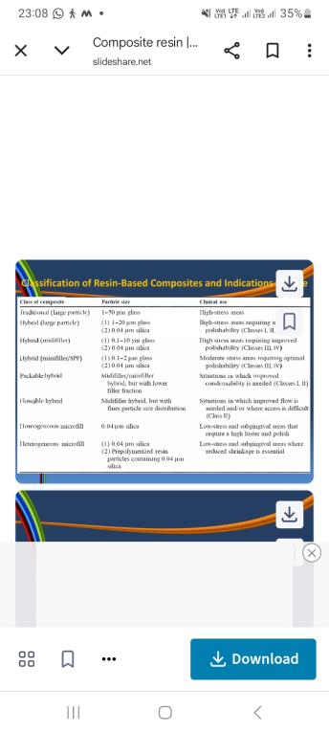

Slide 41
ACCORDING TO POLYMERIZATION
REACTION ::
Chemically / Self Activated Composite Resins
Light Activated Compostie Resins
* Ultraviolet (UV) light
wave length = 200 – 400 nm
* Visible light
wave length = 420 – 450 nm

Slide 42
ACCORDING TO THE FILLER SIZE ::
Average Particle size
Conventional / Macrofilled 8 - 12 μm
Small particle 1 - 5 μm
Microfilled 0.04 - 0.4 μm
Hybrid 1.0 μm

Slide 43
ACCORDING TO THE USE ::
For Anterior teeth restoration
e.g. - Microfilled
For Posterior teeth restoration
e.g. - Conventional & Hybrid

Slide 44
TYPE OF COMPOSITES ACCORDING TO POLYMERIZATION REACTION

Slide 45
CHEMICALLY ACTIVATED RESINS
Two Paste system –
* Base Paste contains ,,,,
Benzoyl peroxide - initiator
* Catalyst Paste contains ,,,,
Tertiary amine - activator
(N-N dimethyl - p - toluidine)

Slide 46
Setting Reaction ---
When 2 pastes are spatulated , the amine reacts with
the Benzoyl peroxide to form the free radicals which
starts the polymerization .

Slide 47
LIGHT ACTIVATED RESINS
UV - Light activated systems :::
It is the first light activated system to activate the
free radicals.
Limitations ,,,,,
Limited penetration of the light into the resin. Thus
difficult to polymerize thick sections.
Lack of penetration through tooth structure.

Slide 48
Visible - Light activated systems :::
Ability to polymerize thicker sections .
Totally replaced the UV light system .
Most widely used than the chemically activated system.
Supplied as ,,,,,,,
Single paste system , containing –
Photoinitiator ----- Camphoroquinone 0.25 wt. %
Amine accelerator ----- DEAEMA 0.15 wt. %
(Diethyl-amino-ethyl-methacrylate)

Slide 49
Setting reaction ,,,,,
When exposed to light of the correct wave length
( 400 -500 nm ) the photoinitiator is activated and
reacts with the amine to form the Free radicals .

Slide 50
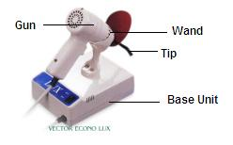


LIGHT DEVICES / LIGHT CURING UNITS –
Transmit light of the proper wavelength to the site
of the restoration , by means of light guide composed
of fiberoptic bundles .

Slide 51
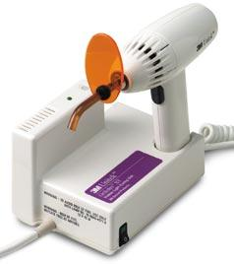
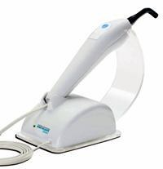
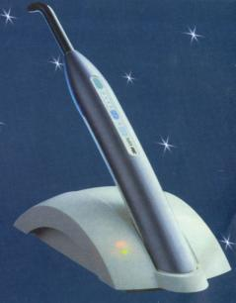
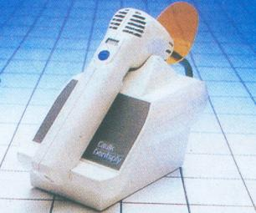
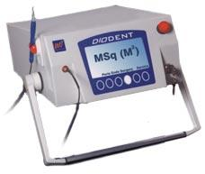
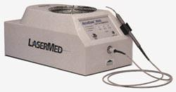
L E D
CORDLESS
LASER
ARGON LASER

Slide 52
Light source is usually a Tungsten Halogen
light bulb .
White light is generated by the bulb passes
through the filter that removes the infrared &
visible spectrum for wavelength greater than
about 500 nm .

Slide 53
DEGREE OF CONVERSION / POLYMERIZATION –
Conversion of monomer to polymer (polymerization)
depends on –
Transmission of light through the material -- Controlled
by absorption & scattering of light by Filler particles
Amount of Photoinitiator & Inhibitor present
Time of exposure – Low intensity light = 80 to 240 sec.
High intensity light = 20 to 60 sec.

Slide 54
OPTICAL MODIFIERS –
To simulate tooth structure ,Translucency or Opacity is provided by adding minute amount of
Optical modifiers , such as ,,,,,,,,
Titanium dioxide
& = .001 to .007 wt. %
Aluminu oxide

Slide 55
SELF ACTIVATED LIGHT ACTIVATED
Activated by peroxide - Requires light of correct
amine system. wavelength.
Bulk placement. Layer by layer placement.
Cures throughout its Cures only where light is
bulk. received.
More porosity. Less porosity.
Requires mixing. No mixing.
Less Working time. More Working time.
Discolored fast. Resistant to Discoloration.
More Wastage. Less Wastage.
Short Shelf life. Long Shelf life.
Requires waiting period Can be finished immediately
for finishing. after curing.

Slide 56
TYPE OF COMPOSITES ACCORDING TO FILLER SIZE

Slide 57
CONVENTIONAL COMPOSITES
Also known as -----
TRADITIONAL COMPOSITES OR MACROFILLED COMPOSITES

Slide 58
COMPOSITION –
Ground Quartz is most commonly used as filler.
Wide distribution of particle size.
Particle Size = 8 to 12 μm
But may be as large as 50 to 100 μm .
Filler loading = 70 to 80 wt. %
or
50 to 60 vol. %

Slide 59
PROPERTIES –
Compressive strength -- 250 to 300 MPa
4 to 5 times greater than unfilled resin.
Tensile strength -- 50 to 65 MPa
Double that of Unfilled resin.
Elastic modulus -- 8 to 15 GPa
4 to 6 times greater than Unfilled resin.

Slide 60
Hardness -- 55 KHN
3 to 4 times greater than Unfilled resin .
Water sorption -- 0.5 to 0.7 mg/cm²
3 times Less than that of Unfilled resin .
Co-Efficient of thermal expansion -- 25 to 35 x 10⁻⁶ / ⁰C
3 to 4 times less than Unfilled resin .

Slide 61
Esthetics --
* Polishing of Conventional composite results in
a rough surface .
* Tendency to stain over a period of time .
Radiopacity --
* Composites using Quartz as a filler are radioluscent.
* Radiopacity is less than dentin .

Slide 62
CLINICAL CONSIDERATION –
Rough surface develops as a result of abrasive wear of the soft resin matrix , due to tooth brushing and mastication .
Poor resistance to Occlusal wear .
Tendency to Discolor , due to rough surface .
Resin matrix does not bond to tooth structure .

Slide 63
MICROFILLED COMPOSITES
Also known as Nanofilled Composites .
Developed to overcome the problems of
surface roughness of Conventional
Composites.
Smoother surface , due to incorporation of
microfillers .

Slide 64
COMPOSITION --
Colloidal Silica used as a microfillers (inorganic filler)
Particle size of Colloidal silica ,,,,,
0.02 to 0.04 μm
200 to 300 times smaller than the quartz fillers
of Conventional composites .

Slide 65
Problem with Colloidal Silica ,,,,,
It has a large surface area that could not be
adequately wetted by the resin matrix .
Inorganic Filler content / loading ,,,,,,
only 50 % by wt.
( Conventional composite has 70-80 wt. % )

Slide 66
Methods to increase Filler loading ::
Sinter the colloidal silica ,,,
thereby forming larger agglomerate which results in
reduced surface area .

Slide 67
Addition of Prepolymerized fillers ,,,
Also known as Organic fillers .
This is most common method .
Prepared by adding 60 -70 wt.% of silane
coated colloidal silica to the monomer, which
is held at slight high temp. to reduce the
viscosity .
It is then heat cured & ground .

Slide 68
Inorganic filler content after inclusion of
Prepolymerized fillers ,,,,,
80 % by wt.
70 % by vol.

Slide 69
PROPERTIES –
Except Compressive strength , all other physical &
mechanical properties are inferior to the other
composite resins.
COMPRESSIVE STRENGTH ::
250 to 350 MPa .
Similar to Conventional composites .

Slide 70
TENSILE STRENGTH ::
30 to 50 MPa .
Lowest among composites .
MODULUS OF ELASTICITY ::
3 to 6 MPa
Lowest .
HARDNESS ::
25 to 30 KHN
Lowest .

Slide 71
THERMAL EXPANSION COEFFICIENT ::
50 to 60 x 10⁻⁶ / ⁰C
Highest among the composite resins .
WATER SORPTION ::
1.4 to 1.7 mg / cm2
Highest
ESTHETICS ::
Provide Smooth finished surface desired for
esthetics .

Slide 72
CLINICAL CONSIDERATIONS –
Resin of choice for esthetic restoration of anterior
teeth , especially in non – stress bearing area .
Potential for greater fracture in Class IV & II
restorations .

Slide 73
SMALL PARTICLE COMPOSTIE
Introduced in an attempt to have good
surface smoothness with improved
Physical & Mechanical properties .

Slide 74
COMPOSTION –
Inorganic fillers are ground to smaller size than the
Conventional composites .
Average Filler Size ,,,,
1 – 5 μm but broad distribution .
Filler content / loading ,,,,
80 % by wt.
70 % by vol.

Slide 75
** Primary filler is silane - coated ground particles.
Fillers utilize ,,,,
Glasses containing heavy metal. Ground quartz
is also used.
Colloidal silica is also added in small amounts
i.e. 5 wt.% to adjust the paste viscosity .

Slide 76
PROPERTIES –
Best physical & mechanical properties , due to higher filler content .
Compressive Strength :: 350 to 400 MPa
Highest
Tensile Strength :: 75 to 90 MPa
Double than Microfilled & 50% greater than
that of Conventional composite .

Slide 77
Modulus of Elastisity :: 15 to 20 GPa
Stiffest of all
Hardness :: 50 to 60 KHN
Similar to Conventional
Thermal Expansion Coefficient :: 19 to 26 x 10⁻⁶ / ⁰C
Lower than other Composites , but twice that of
tooth structure .

Slide 78
Water Sorption :: 0.5 to 0.6 mg / cm²
similar to Conventional .
Esthetics :: Better than conventional .
Polymerization Shrinkage :: Less than conventional .
Radiopacity :: Contains heavy metal glasses as
fillers , which are radiopaque.
Important property for material used
in posterior teeth .

Slide 79
CLINICAL CONSIDERATION –
Can be used in areas of stress , such as Class IV & II
restoration .
Provides smooth surfaces for anterior teeth , but are
still not as good as Microfilled & Hybrid composites .

Slide 80
HYBRID COMPOSITES
Latest category of composite material .
Developed to obtain better surface smoothness than
the Small particles , yet maintaining the properties .
Have surface smoothness & esthetics competitive with
Microfilled composites for anterior restorations.

Slide 81
COMPOSITION –
Filler content –
75 to 80 % by wt.
60 to 65 % by Vol.

Slide 82
Two kinds of filler particles are employed ,,,,
Colloidal Silica –
Present in a higher concentration 10 to 20 wt %
Ground particles of Glasses containing heavy metals –
* Average particle size = 0.6 to 1 μm
* 75 % of the ground particles are smaller
than 1.0 μm .

Slide 83
PROPERTIES –
Range between Conventional & Small particle
composites , but generally superior to Microfilled .
Compressive Strength :: 300 to 350 MPa
Slightly less than the Small particle composite .
Tensile Strength :: 70 to 90 MPa
Comparable to Small particle composite .

Slide 84
Elastic Modulus :: 7 to 12 GPa
Ranges b/w Conventional & Microfilled composites .
Hardness :: 50 to 60 KHN
Similar to Small particle composites .
Coefficient of Thermal Expansion :: 30 to 40 x 10⁻⁶ / ⁰C
Less than the Microfilled .

Slide 85
Water Sorption :: 0.5 to 0. 7 mg / cm²
Similar to Conventional & Small partilce , but less
than Microfilled composites .
Esthetics ::
Competitive to Microfilled composite for anterior
teeth .
Radiopacity ::
Presence of heavy metal glasses makes it more
radio – opaque than Enamel .

Slide 86
CLINICAL CONSIDERATION –
Widely used for Anterior restoration , including
Class IV .
Also used in stress – bearing area , even though its
mechanical properties are inferior to Small particle
composties .

Slide 87
COMPOSITE RESINS FOR POSTERIOR RESTORATIONS

Slide 88
All types of Composites are used for posterior
restorations.
Cavity preparation should be Conservative
and should use adequate manipulation
technique .

Slide 89
INDICATIONS OF COMPOSITE FOR POSTERIOR TEETH –
When Esthetics is necessary .
When pt. is Allergic to mercury .

Slide 90
PROBLEMS IN USE OF COMPOSITES FOR POSTERIOR RESTORATIONS –
In Class V restoration ,
when gingival margin is located in cementum or
dentin , the material shrinks away from the margin
leading to a gap .
Placement technique is more time consuming .

Slide 91
Composites wear faster than Amalgam .
Newer materials like Small particle & Hybrid
have less wear ( 20 um per year ) which
approaches that of Amalgam ( 10 um per year ) .

Slide 92
MANIPULATION OF COMPOSITE RESINS OR TECHNIQUES OF INSERTION

Slide 93
CHEMICALLY ACTIVATED COMPOSITES
2 paste systems .
Equal amount of paste are dispensed onto a mixing pad .
Mixing by rapid spatulation for 30 sec. with Plastic
instrument .
Inserted with plastic instrument or syringe .
Matrix strip may be used to apply pressure for 15 min.

Slide 94
LIGHT ACTIVATED COMPOSITES
Single component pastes .
Require no mixing .
Working time is under the control of operator .
Exposure to curing light initiate polymerization .
Exposure time is b/w 40 to 60 sec.
Depth of cure is limited .
Resin thickness should not be greater than 2.5 mm .

Slide 95
ACID ETCHING TECHNIQUE –
Most effective ways of improving the marginal seal &
mechanical bonding b/w Resin and Enamel .
Mode Of Action ::
It creates micro-porosities by etching of the enamel .
Etching increase the surface area .
Etched enamel has a high surface energy and allows a
resin to wet the surface & penetrate into micro-porosities

Slide 96
Acid Used ::
37 % Phosphoric acid is most commonly used acid .
Supplied in gel form .
Brush or Syringe is used for application on the
enamel .

Slide 97
Procedure ::
Dry the enamel surface completely .
Length of application = 60 sec.
but may be 15 sec.
After etching , dried enamel shows white , frosted
appearance .
If enamel surface is contaminated , re-etching for 10 sec .

Slide 98
BOND AGENTS –
ENAMEL BOND AGENTS :: Unfilled resin
DENTIN BOND AGENTS ::
First generation
Second generation
Third generation
Forth generation
Fifth generation
Primers / Conditioners
Bonding liquid

Slide 99
SANDWICH TECHNIQUE --
Tooth surface + GIC + Composite

Slide 100
PIT & FISSURE SEALANTS --
Cyanoacrylate
Polyurethenes
BIS - GMA

